Slide 1
El pretérito
The preterite tense

Slide 2
The preterite is one of 2 past tenses in Spanish.
Both the preterite and the imperfect are used to talk about things that have already happened or that were happening.

Slide 3
Preterite Conjugation
To conjugate in the preterite tense follow the same steps as the present tense.
1. Drop the – ar, - er, - ir ending. 2. Add the preterite endings to match the subject.
*There are no stem changers for –ar/-er verbs, there are for –ir verbs.

Slide 4
Endings
-AR
é amos
aste
ó aron
ER/-IR
í imos
iste
ió ieron

Slide 5
Preterite Translation
The preterite is often translated as: (verb)ed did (verb)
Ejemplos: yo bailé – I danced, I did dance tú vendiste – you sold, you did sell ella corrió – she ran, she did run nosotros recibimos – we received, we did receive

Slide 6
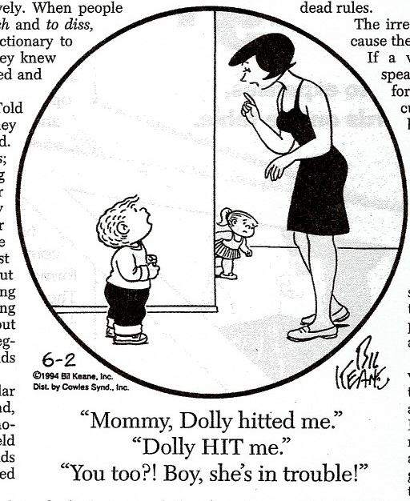
Unfortunately there are MANY IRREGULAR VERBS in the preterite tense that will have to be memorized . . .soon!

Slide 7
Una Práctica del Pretérito
caminar – tú
abrir – ellos
volver – nosotros
lavarse – yo
comer – el chico
decidir – yo
viajar – los alumnos
divertirse – tú
llamar – Sara
entregar – nosotros

Slide 8
Una Práctica del Pretérito
caminar – tú
abrir – ellos
volver – nosotros
lavarse – yo
comer – el chico
caminaste
abrieron
volvimos
me lavé
comió

Slide 9
Una Práctica del Pretérito
decidí
decidir – yo
viajar – los alumnos
divertirse – tú
llamar – Sara
entregar - nosotros
viajaron
te divertiste
llamó
entregamos

Slide 10
Traduce al español.
Ella ayudó
She helped –
I did write –
You (fam.) got ready –
They drank –
We did listen –
Yo escribí
Tú te preparaste
Ellos bebieron
Nosotros escuchamos

